Slide 1
Products Abstract Classes and Polymorphism

Slide 2
Product Management
Books and CDs are Products.
Product is a super class of Book and CD.
Each product has name and a price
Each product should have an increarePrice() method
Must be declared in Product class as an abstract method
Product class is an abstract class
Additional data fields in subclasses:
Books have author and page count
CDs have artist and year

Slide 3
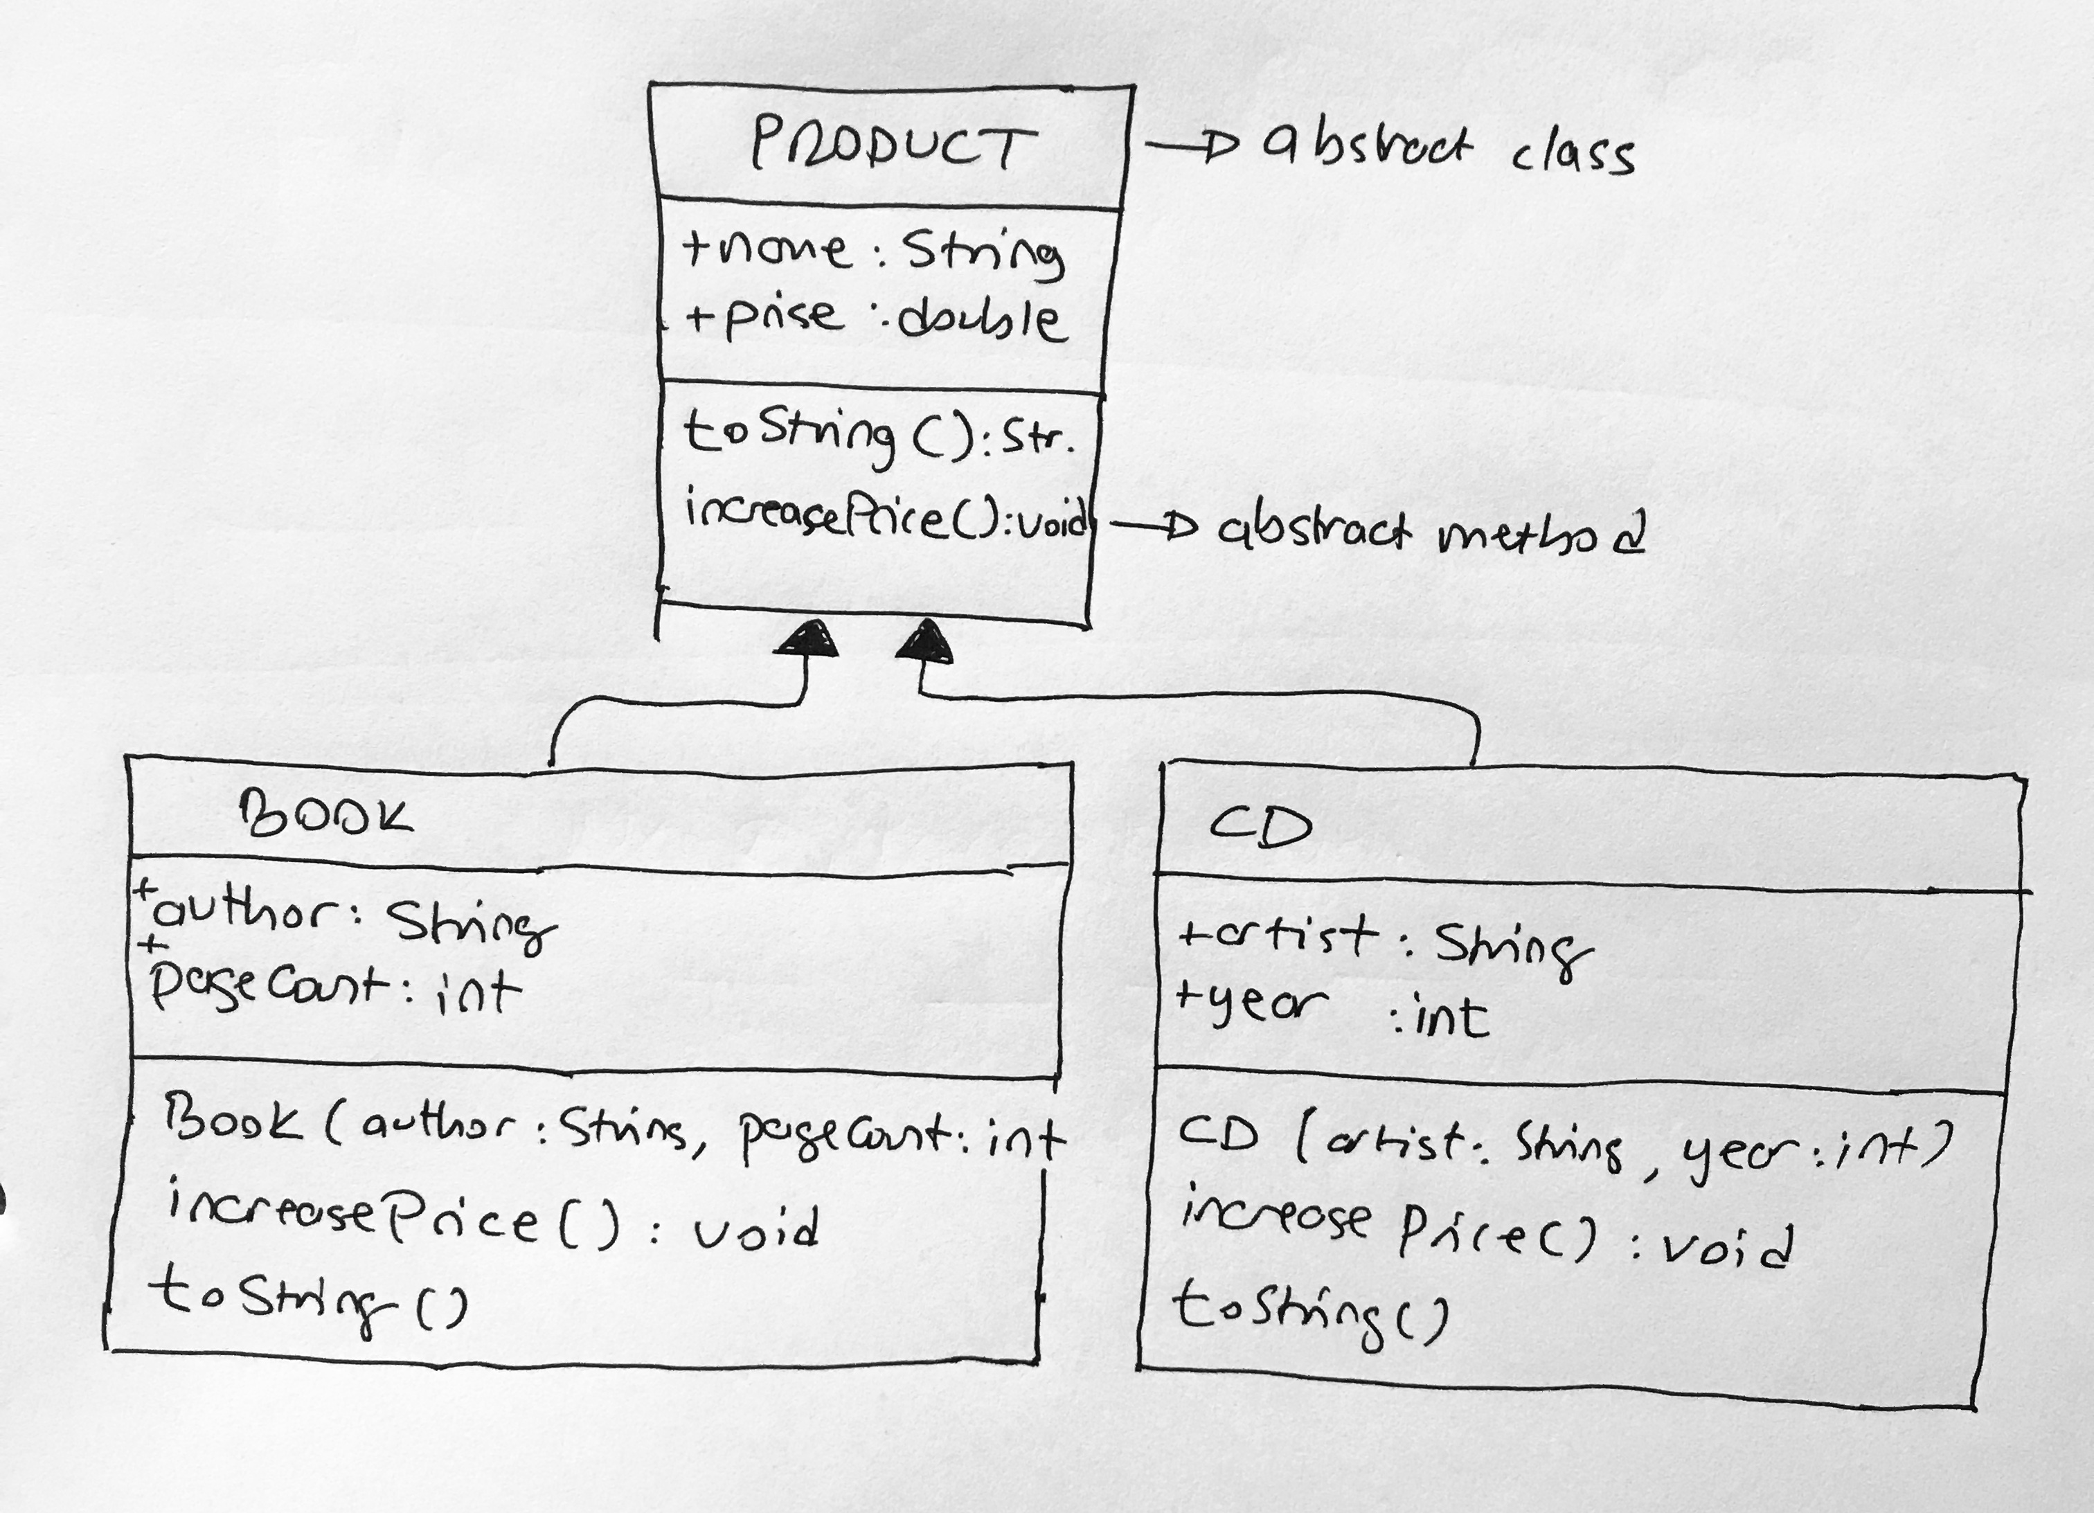
UML Diagrams

Slide 4
All products are stored in products.txt file
Books are stored in lines that start with BOOK
Book lines contain the following information: Name of the book, price, author name, and page count
CDs are stored in lines that start with CD keyword
CD lines contain: album name, price, album release year, and artist information
Example products.txt file:
BOOK;OOP;150;LIANG;1203
BOOK;PYTHON;100;JOHN;600
BOOK;DATABASE;30;ROBERT;304
CD;AQUA;20;1980;MARILLION
CD;ASTRA;30;1986;ASIA
BOOK;ALGORITHM;98;ALICE;450
CD;SHAMAL;55;1977;GONG

Slide 5
Program Requirements
Your program should read the products.txt file and loads all products into a single array list (named: products array list)
Type of the products array list should be Product
In the main code, write a method which increases each product’s price found the input array list.
Book prices always increase by %10.
CD prices always increase by %50.
These price increase details are coded in each subclasses’ increasePrice methods.
Sample method call: increaseAllPrices(products); // void method. input is an array list of products.
Display all products before and after price increase method call.

Slide 6
Sample Program Output
Initial prices:
Book author=LIANG, pageCount=1203 name=OOP, price=150.0
Book author=JOHN, pageCount=600 name=PYTHON, price=100.0
Book author=ROBERT, pageCount=304 name=DATABASE, price=30.0
CD artist=MARILLION, year=1980 name=AQUA, price=20.0
CD artist=ASIA, year=1986 name=ASTRA, price=30.0
Book author=ALICE, pageCount=450 name=ALGORITHM, price=98.0
CD artist=GONG, year=1977 name=SHAMAL, price=55.0
After price increase:
Book author=LIANG, pageCount=1203 name=OOP, price=165.0
Book author=JOHN, pageCount=600 name=PYTHON, price=110.0
Book author=ROBERT, pageCount=304 name=DATABASE, price=33.0
CD artist=MARILLION, year=1980 name=AQUA, price=40.0
CD artist=ASIA, year=1986 name=ASTRA, price=60.0
Book author=ALICE, pageCount=450 name=ALGORITHM, price=107.8
CD artist=GONG, year=1977 name=SHAMAL, price=110.0

Slide 7
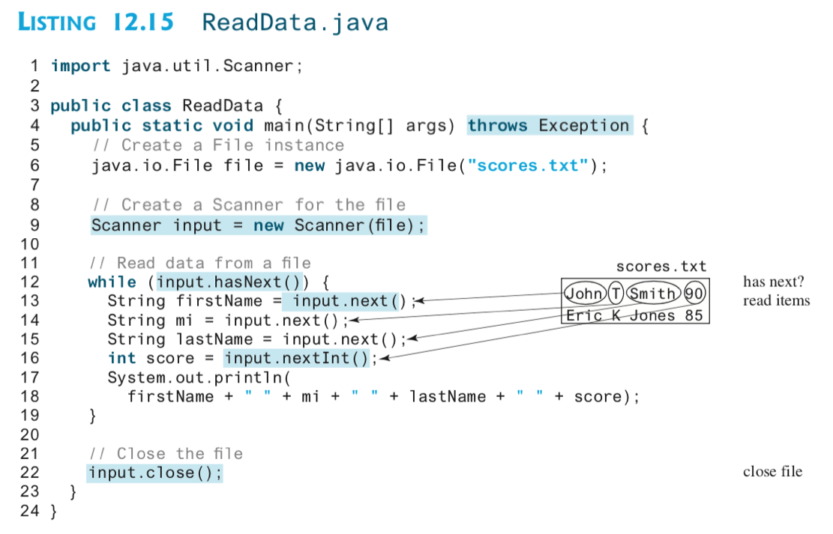
Read Data from a Text File: Example

Slide 8
Hints
To convert a string to an integer, use Integer.parseInt() method.
Similar method is also available for Double types.
You can split a string based on a delimiter character using split() method.
Usage: String[] parts = str.split("#") splits str using the # symbol and returns parts of the string in a String array

